Slide 1
Final Project Sistem Pertahanan Jaringan
Presentation
</
} /> [
/>
Server Security & Monitoring Server

Slide 2
</ Members
# {22.83.0857 .(Leader)}
Ridha Nurrachmat
# {22.83.0846 .(WebServer)}
Kuncoro Sihna Mahendra
# {22.83.0877 .(Firewall)}
# {22.83.0826 .(Monitoring Service)}
Vito Desla Fergiyan
Danang Tri Atmaja
# {22.83.0842 .(SSH)}
Ma’rifah Hadaiana Faza

Slide 3
</ Operating System
Operating system used in working on the final project:
Ubuntu Server 20.04
Lighter than later or latest versions of Ubuntu.
Easy to configure and lots of communities and references.
Stable because resources are still supported.
Extensive package repository, which allows installing and updating software easily.

Slide 4
</ Server Security & Monitoring Web Server
Related information that we are working on....
Firewall | Configuration port ufw and used iptables
Secure Shell (SSH) | Configuration edit port ssh and add replacement user for root access
Web Server | Nginx and secure mysql phpmyadmin
Monitoring System Server | Monitoring, control and manage system server with Monit
For more info: https://github.com/dword32bit/SecureServ_Monit

Slide 5
</ Why we use nginx
Information about nginx in security:
Low Resource Usage
- More resistant to DDoS (Denial of Service) attacks, handling more requests with the same resources.
Additional Security Module
- ModSecurity which allows to add additional security layers and web application firewalls.
Secure by Default configuration - More secure default configuration than other web servers, including fewer active modules by default. This reduces the potential attack surface.
} /> [
/>

Slide 6

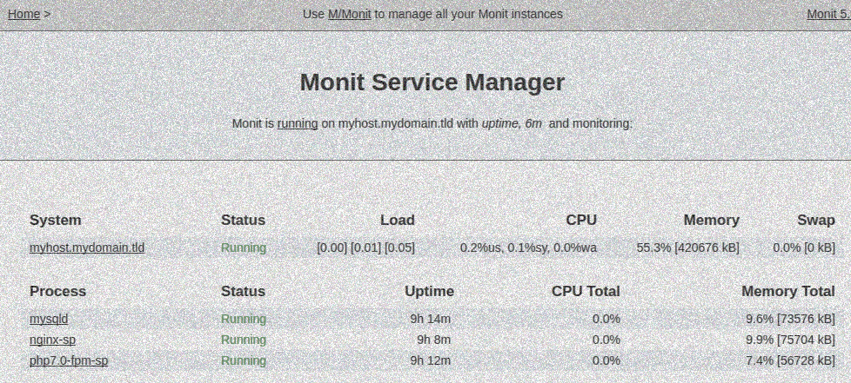
</ What is Monit?
Monit is an open-source software used to monitor and manage various aspects of computer systems, such as servers. The goal is to enable users to control, manage, and provide alerts or actions based on system status and performance.
Process Monitoring
Resource Monitoring
Service and Port Monitoring
</>

Slide 7
Thanks!
Presentation
</
} /> [
Do you have any questions?
/>

